Slide 1
Computer Networks
Link Layer - Services and
Addressing
S.V.Jansi Rani
Associate Professor / CSE

Slide 2
Agenda
Introduction to Link Layer
Link, nodes, services , point ot point and broadcast links
Link Layer Addressing
Three types of addressing, ARP protocol

Slide 3



Slide 4
INTRODUCTION
The Internet is a combination of networks glued together by connecting devices (routers or switches). If a packet is to travel from a host to another host, it needs to pass through these networks.

Slide 5
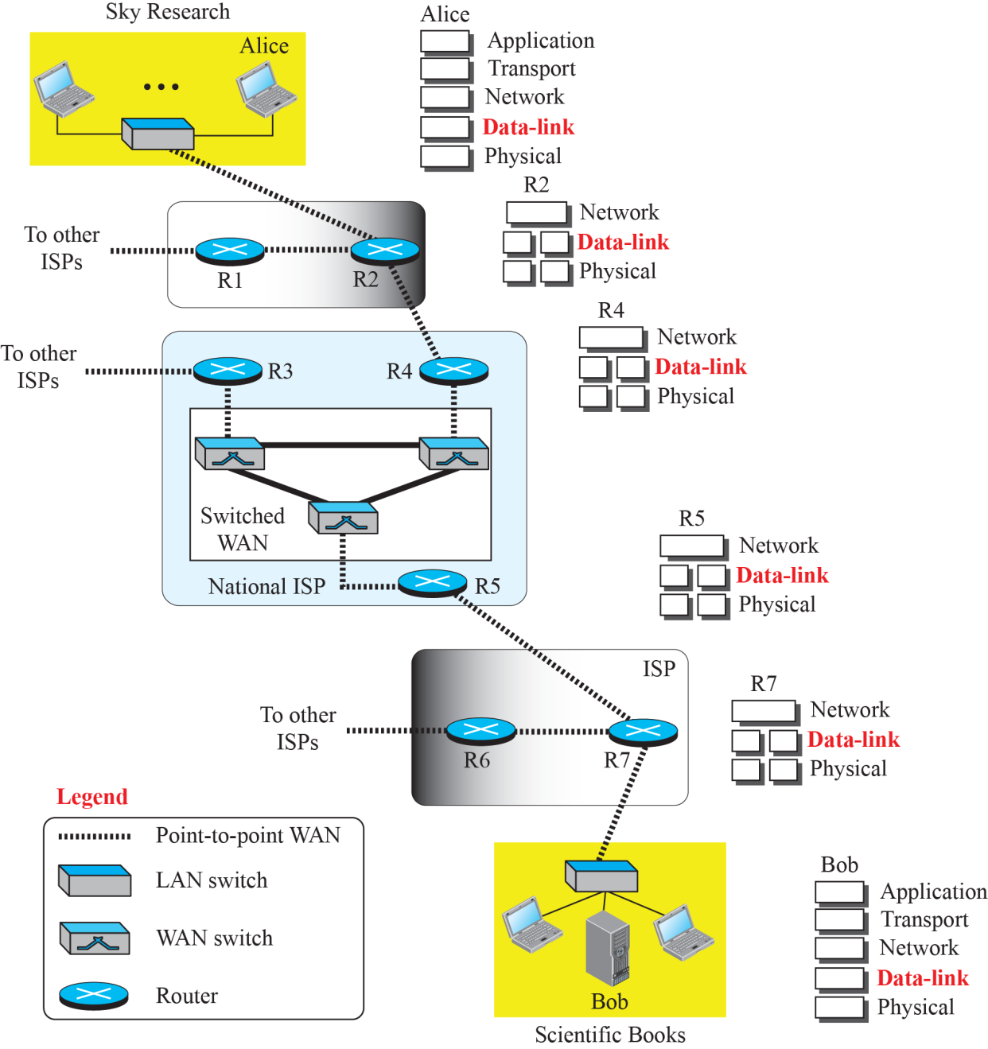
Communication at the data-link layer

Slide 6
Nodes and Links
- Node-to-node
- Data unit from one point in the Internet needs to pass through many networks (LANs and WANs) to reach another point.
- LANs and WANs are connected by routers.
- It is customary to refer to the two end hosts and the routers as nodes and the networks in between as links.

Slide 7
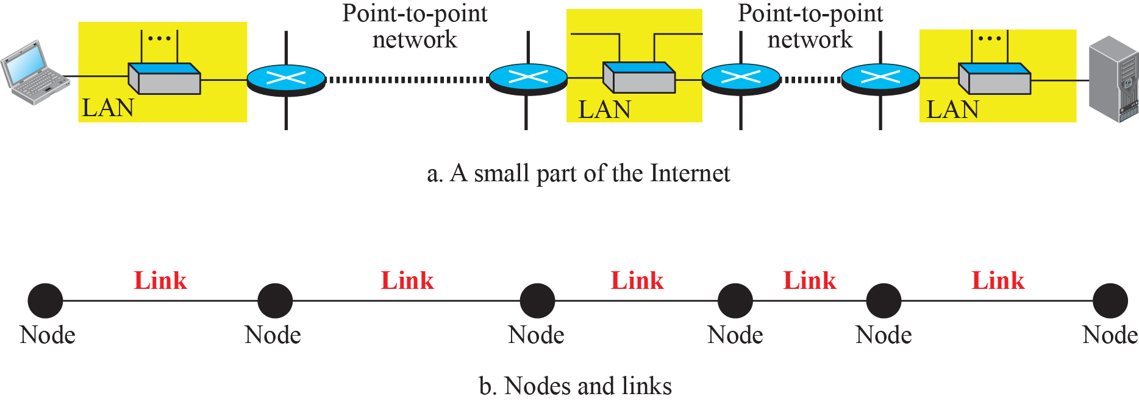
Nodes and Links

Slide 8
Services
The data-link layer is located between the physical and the network layers
Encapsulate datagram/packet in a frame and decapsulate the datagram /packet from the frame - Analogy
Framing
Flow Control - Producer -Consumer
Error Control
Congestion Control - sometimes in WAN

Slide 9

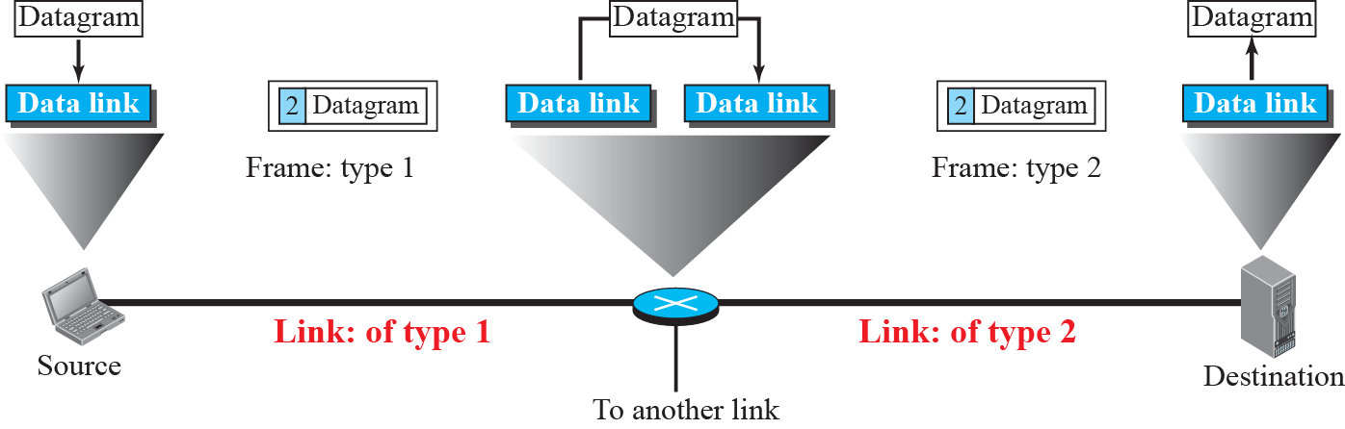
A communication with only three nodes

Slide 10
Two Categories of Links
Data-link layer controls how the medium is used
Point-to-point link or a broadcast link

Slide 11
Two Sublayers
Data Link Control (DLC) and media access control (MAC)
Media access control (MAC) -specific to broadcast link

Slide 12
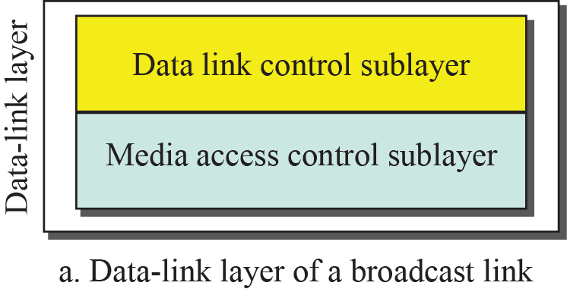
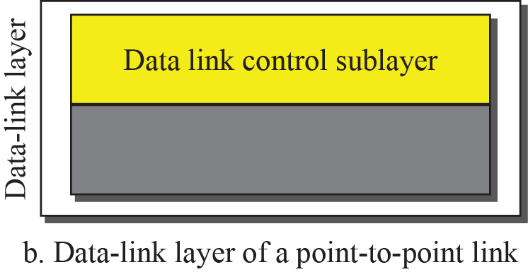
Dividing the data-link layer into two sublayers

Slide 13
LINK-LAYER ADDRESSING
The source and destination IP addresses define the two ends but cannot define which links the packet should pass through.
Link Layer address / MAC Address/ Hardware Address /Physical Address
Encapsulated in a frame and two data-link addresses are added to the frame header
These two addresses are changed every time the frame moves from one link to another.

Slide 14
Ld,Ls,Ns,Nd

Slide 15
IP addresses and link-layer addresses in a small internet

Slide 16
More....?
If the IP address of a router does not appear in any datagram sent from a source to a destination, why do we need to assign IP addresses to routers?
Why do we need more than one IP address in a router, one for each interface?
How are the source and destination IP addresses in a packet determined?
How are the source and destination link-layer addresses determined for each link?

Slide 17
Three Types of addresses
Some link-layer protocols define three types of addresses:
Unicast
Multicast
Broadcast

Slide 18
Example
Unicast link-layer addresses in the most common LAN, Ethernet, are 48 bits (six bytes) that are presented as 12 hexadecimal digits separated by colons; for example, the following is a link-layer address of a computer.
LSB of first byte should be 0.
A2:34:45:11:92:F1
9.18

Slide 19
Example
Multicast link-layer addresses in the most common LAN, Ethernet, are 48 bits (six bytes) that are presented as 12 hexadecimal digits separated by colons. LSB of first byte should be 1.
A3:34:45:11:92:F1
9.19

Slide 20
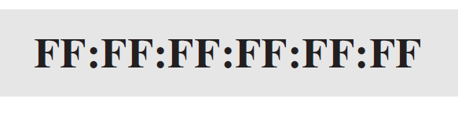
Example
Broadcast link-layer addresses in the most common LAN, Ethernet, are 48 bits, all 1s, that are presented as 12 hexadecimal digits separated by colons. The following shows a broadcast address:
9.20

Slide 21
Address Resolution Protocol (ARP)
Anytime a node has an IP datagram to send to another node in a link, it has the IP address of the receiving node. However, the IP address of the next node is not helpful in moving a frame through a link; we need the link-layer address of the next node. This is the time when the Address Resolution Protocol (ARP) becomes helpful.

Slide 22
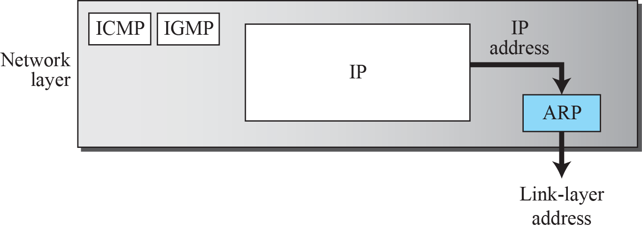
Position of ARP in TCP/IP protocol suite

Slide 23
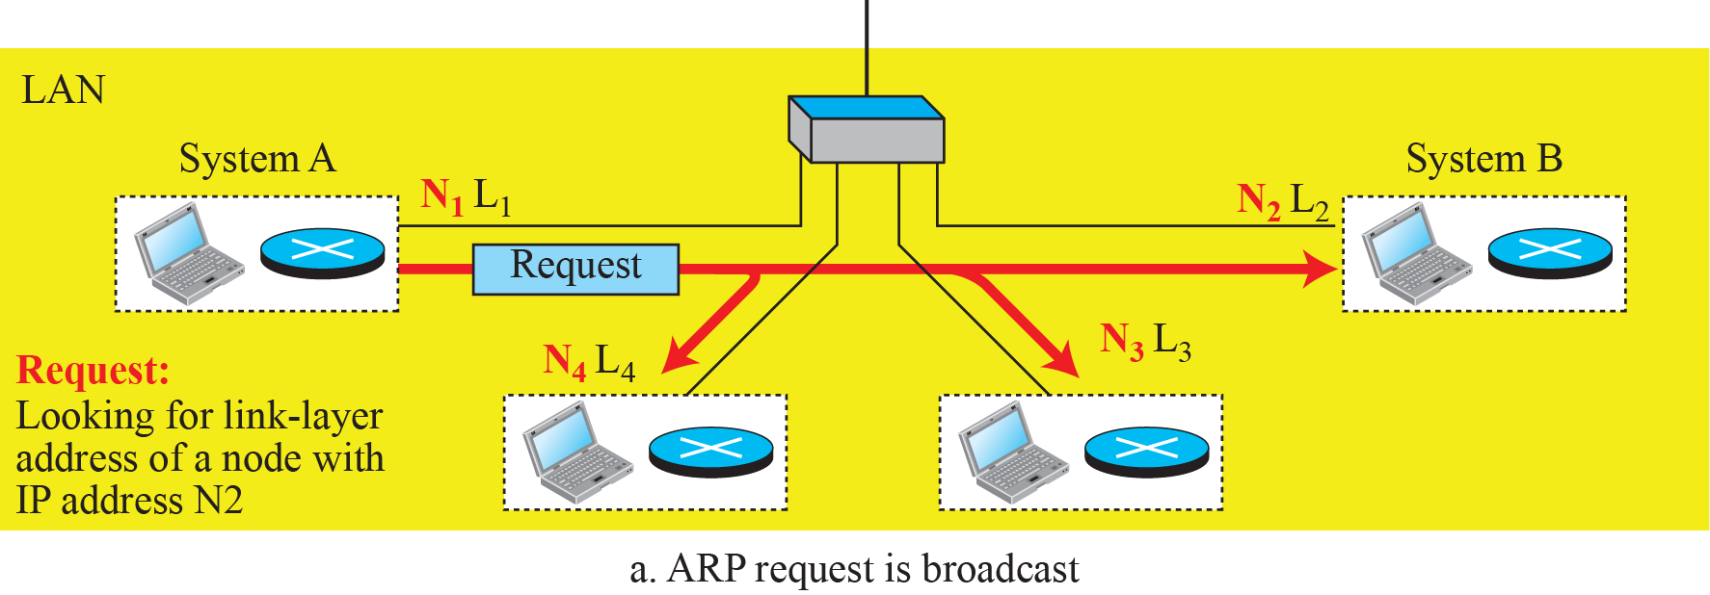
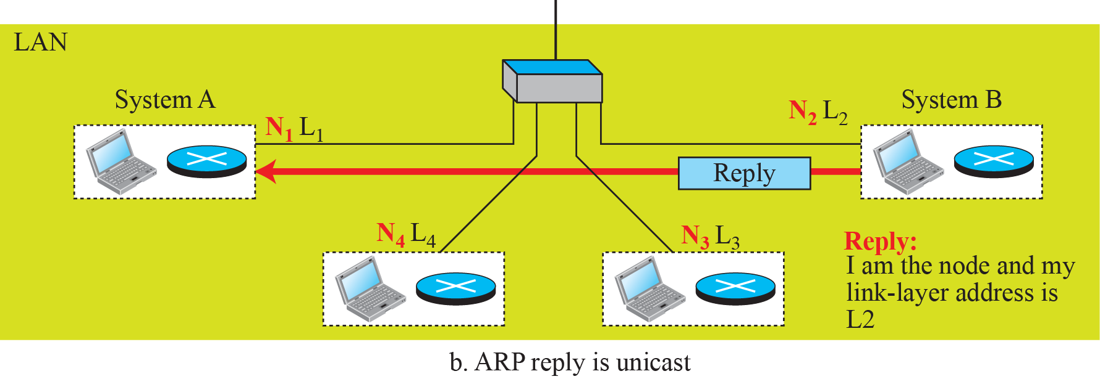
ARP operation

Slide 24
Instead of sending one broadcast frame (ARP request), one unicast frame (ARP response), and another unicast frame (for sending the datagram), system A can encapsulate the datagram and send it to the network. System B receives it and keep it; other systems discard it.
Eg: 20 systems. A to B. 180 frames , 18 frames

Slide 25
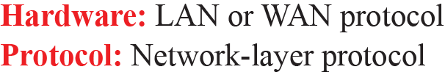
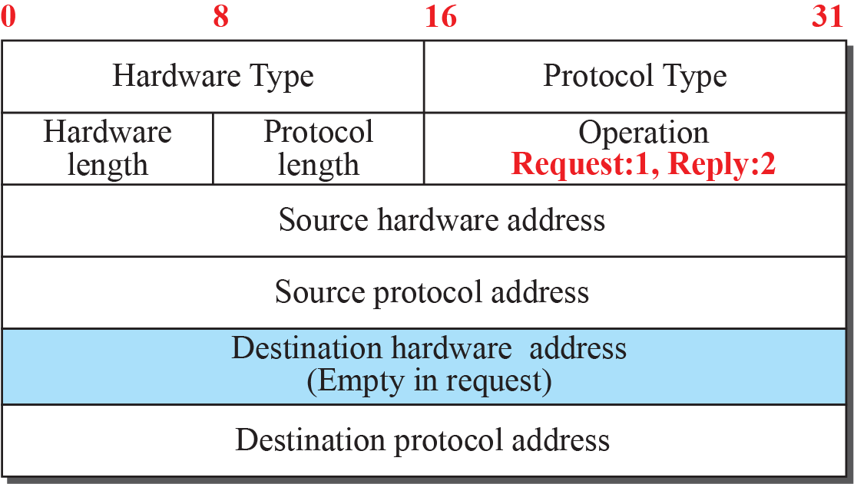
ARP packet

Slide 26
Example
A host with IP address N1 and MAC address L1 has a packet to send to another host with IP address N2 and physical address L2 (which is unknown to the first host). The two hosts are on the same network.
9.26

Slide 27
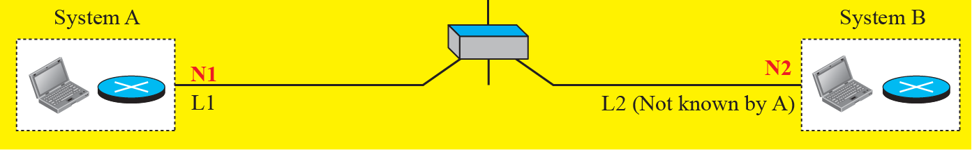
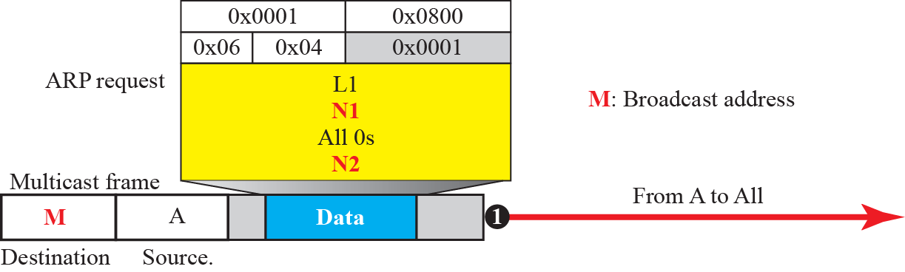
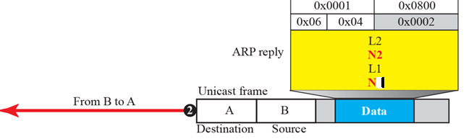
Example 9.4

Slide 28
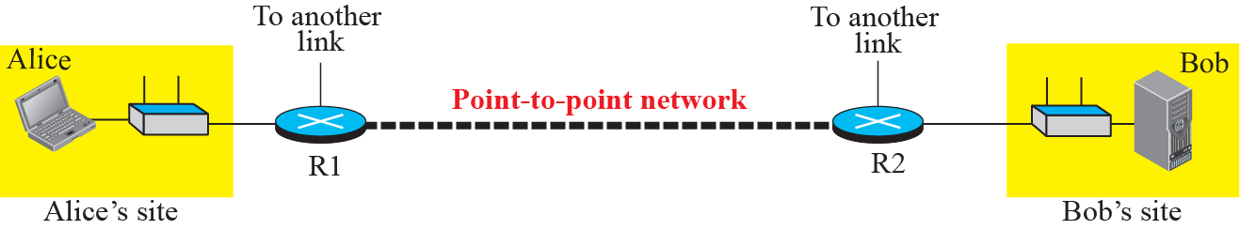
The internet for our example

Slide 29
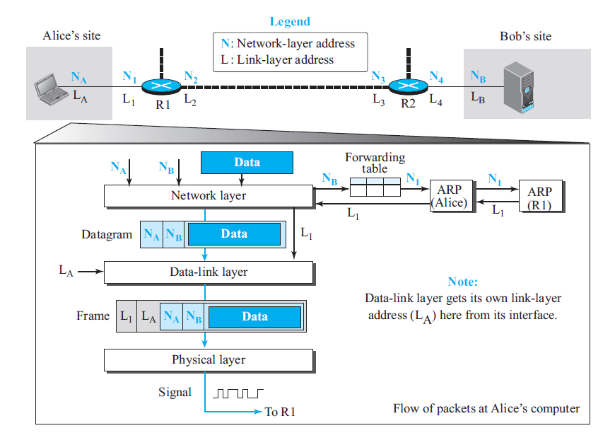
Flow of packets at Alice site

Slide 30
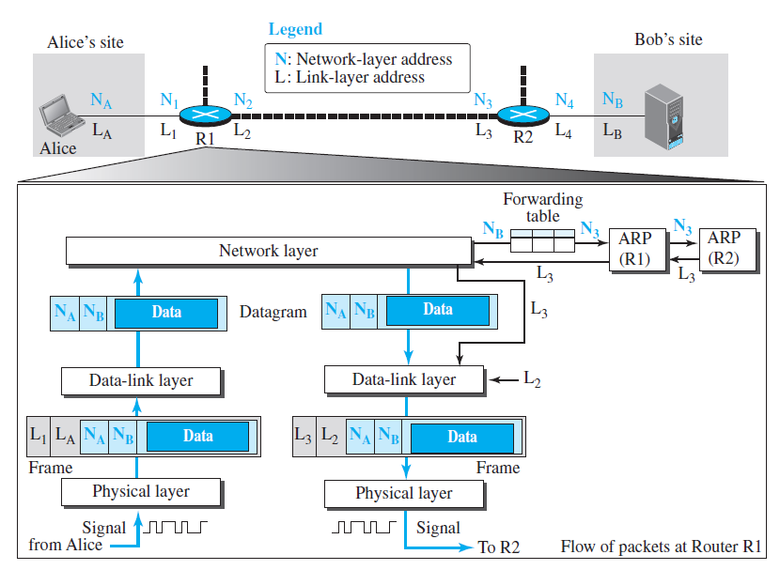
Flow of activities at router R1

Slide 31
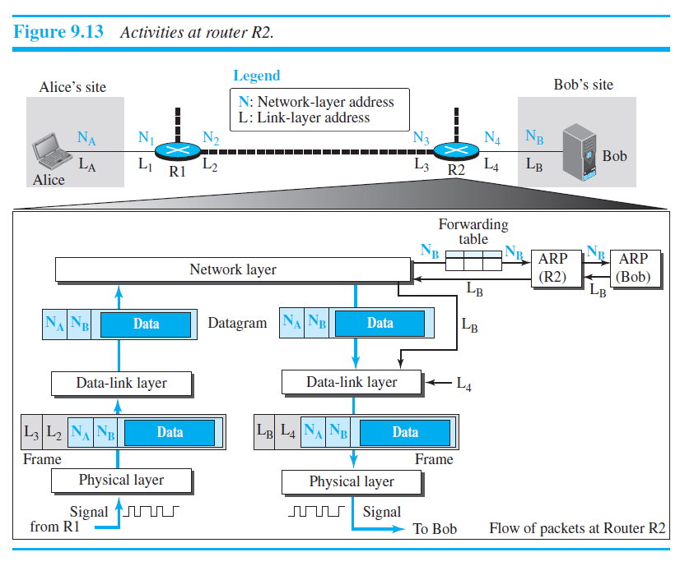

Slide 32
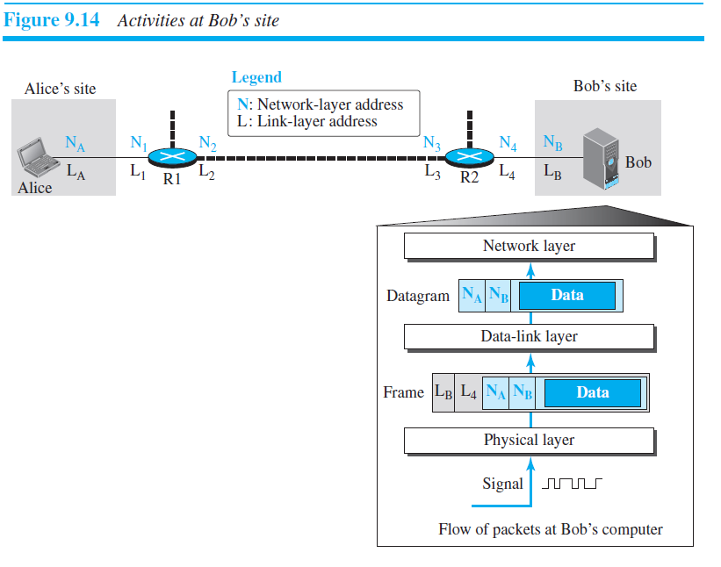

Slide 33
Outcome
Student should be able to
Understand about link, nodes, point to point and broadcast links
Services of Data Link Layer
Demonstrate the different addressing of link layer
Explalin how ARP works

Slide 34
Test Your Understanding
A message transfers from A to B via, R1,R2,R3. During intial configuration when R2 sends ARP request, what is link layer address of R3? ______________
List out the functions of link layer __________, _____,_________

Slide 35
THANK YOU

